Slide 1
Stretches for Athletes

Slide 2
10 stretches for athletes
Each of the stretches below will help you remain stronger and injury-free.
Hold each of the stretches for 10-20 seconds for the better results.

Slide 3
Runner’s lunge with side stretch
Directions:
Assume a lunge position with your forward knee bent over your foot and your back leg extended behind you.
Bring your opposite arm over your head and lean into the stretch.
Drop your knee to the ground for a deeper stretch.
Repeat on the opposite side.
Muscles stretched: Hip flexors, obliques (side abs)

Slide 4
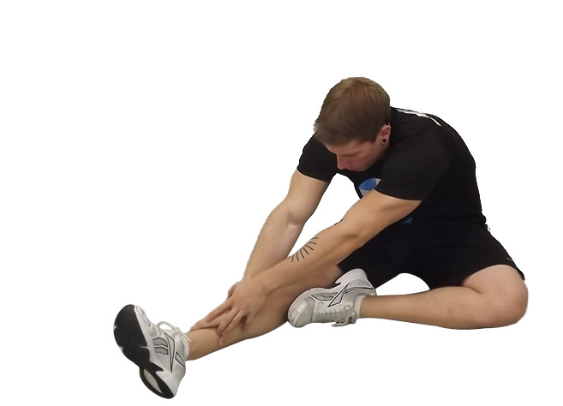
Sitting hamstring stretch
Directions:
Sit on the floor with your legs stretched out in front of you.
Bend one leg in at the knee.
Slowly bend forward from hips toward foot of straight leg until you feel slight stretch.
Hold for 10 to 20 seconds, then repeat on the other side.
Muscles stretched: Hamstrings (back of leg), lower back

Slide 5
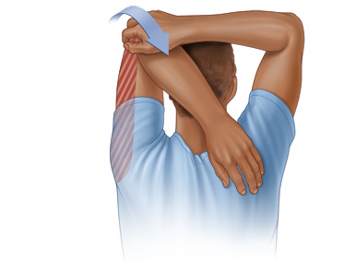
Triceps stretch
Directions:
Put one arm overhead, positioning your forearm as close as possible to your upper arm.
Grasp your elbow overhead with your other hand.
Pull your elbow back and toward your head.
Hold stretch for 10-20 seconds, then repeat with opposite arm.
Muscles stretched: Triceps, lats

Slide 6
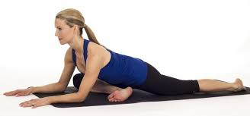
Pigeon pose
Directions:
Cross one knee in front of you while keeping the opposite leg straight behind you.
Place both hands on the ground in front of you and slowly lower your upper body down as low as possible.
Hold for 10-20 seconds then switch sides.
Muscles stretched: Hips, glutes, lower back

Slide 7
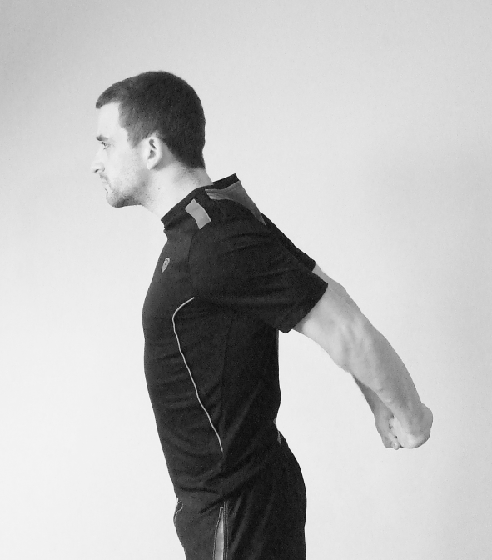
Chest opener stretch
Directions:
Stand or sit with your back straight and shoulders pulled back.
Reach behind you and clasp both hands together.
Bring hands up toward your head as far as possible.
Hold for 10-20 seconds.
Muscles stretched: Chest, shoulders

Slide 8
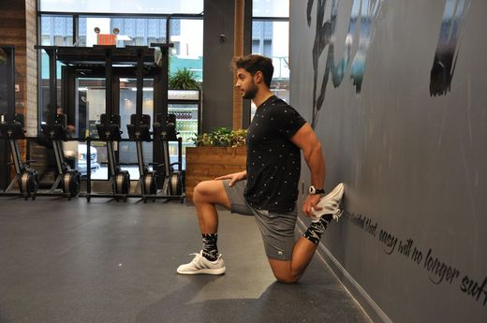
Runner’s lunge with quad stretch
Directions:
Assume a lunge position with your forward knee bent over your foot and your back leg extended behind you.
Drop your knee to the ground.
Reach your arm back and grab your foot or ankle and pull forward to stretch.
Repeat on the opposite side.
Muscles stretched: Hip flexors, quads (front of legs)

Slide 9
Twisted arm stretch
Directions:
Bring your hands out in front and cross your arms, one over the other.
Twist your hands such that the palms face into each other, trying to create contact with your fingers.
Hold for 4 counts, unwind your arms, and then repeat on the other side.
Muscles stretched: Lats, shoulders, triceps

Slide 10
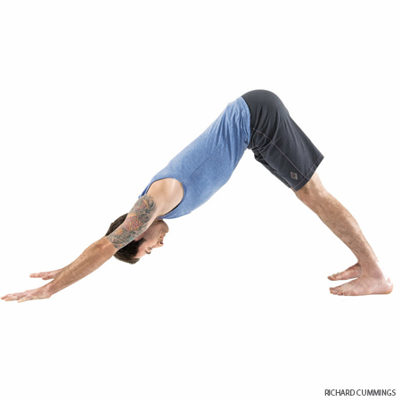
Downward dog
Directions:
Start by kneeling on the ground with your hands shoulder-width apart on front of you.
Take a deep breath and raise your buttocks into the air, straightening your legs as much as possible.
Lower your head toward the ground and straighten your spine.
Lower your heels toward the ground as far as you can go to give your calves a good stretch.
Muscles stretched: Calves; releases tension in back, shoulders

Slide 11
Upward dog
Directions:
Lie face down on the ground with your feet hip-width apart and your hands resting next to your lower ribs.
Keeping your toes and hands on the floor, press your chest up so that your back is straight.
Squeeze your buttocks (to keep your back from hurting) and pull your shoulders back.
You may raise slightly above the ground for a deeper yoga stretch.
Muscles stretched: Chest, abs; opens up shoulders, upper back

Slide 12
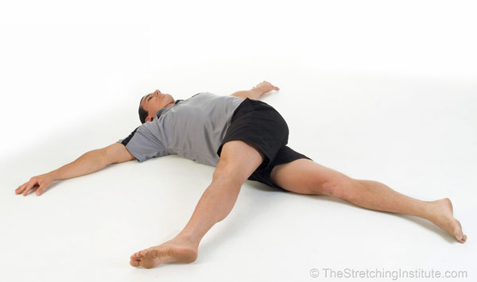
Leg over stretch
Directions:
Lie on your back with your legs straight in front of you.
Bring one leg straight into the air then bring across your body so it rests on the ground.
Hold for 10-20 seconds, then repeat on the other side.
Muscles stretched: Side of hips, lower back, middle back

Slide 13
Basic muscle stretches
These stretches are simple but effective and depending on what your using you should stretch for that muscle.

Slide 14
Calves

Slide 15
Hamstring
HAMSTRING STRETCH - SITTING
While sitting with your leg stretched out, reach forward with your hands towards touching your toes.
SEATED HAMSTRING STRETCH
While seated, rest your heel on the floor with your knee straight and gently lean forward until a stretch is felt behind you knee/thigh.

Slide 16
Quads
QUAD SET - KNEE EXTENSION STRETCH - SEATED
While sitting, tighten your top thigh muscle to press the back of your knee downward towards the ground.
You should feel a gentle stretch in the back of your knee.
QUAD STRETCH - STANDING
While in a standing position, bend your knee back behind and hold your ankle/foot.
Next, gently pull your knee into a more bent position.

Slide 17
Hip flexor
HALF KNEEL HIP FLEXOR STRETCH
While kneeling, lean forward and bend your front knee until a stretch is felt along the front of the other hip.
HIP FLEXOR STRETCH 2
While lying on a table or high bed, let the affected leg lower towards the floor until a stretch is felt along the front of your thigh.
At the same time, grasp your opposite knee and pull it towards your chest.

Slide 18
inner thighs
BUTTERFLY STRETCH
While in a sitting position, bend your knees and place the bottom of your feet together.
Next, slowly let your knees lower towards the floor until a stretch is felt at your inner thighs.
Adductor Stretch
Stand with feet as wide apart as is comfortable. Shift weight to one side as knee bends. Reach towards extended foot and hold. Repeat for other side.

Slide 19
Back
Thoracic Segmental Mobility Stretching Exercise
- Use a 6 inch foam roller for this exercise
- Lay on it crossways, placing it on a stiff spot on your spine
- Place your hands behind your head for support and slowly lift your hips to increase the stretch on your back
Perform the following option if directed by your therapist
- Gently rock back and forth over the foam roller
ANGRY CAT STRETCH
While in a crawl position, draw up your spine to arch your back.

Slide 20
Trapezius
MIDDLE TRAPEZIUS STRETCH
Place your hands and forearms together as shown as you draw your shoulders and shoulder blades forward until a stretch is felt along your upper back.
Scalene and upper trapezius stretches
Scalenes: while sitting up in a chair, put a small towel under your left hip and hold onto the edge of the seat with your left hand. Extend your neck backward, bring your right ear to your right shoulder and gently look to your left till you feel a good stretch.
Upper trapezius: while sitting up tilt your neck forward, tilt your ear toward one shoulder and look toward the other shoulder. Repeat on both sides.

Slide 21
Arms
TOWEL STRETCH
Gently pull up your affected arm behind your back with the assist of a towel
CROSS ARM STRETCH
Grasp your elbow and gently pull it across the front of your body.

Slide 22
Bicep/ Tricep
Wrist Flexor/Bicep Stretch
Holding your wrist like in picture, with elbow completely strait, provide a strong but comfortable stretch, NO PAIN.
TRICEP STRETCH
With your affected elbow bent and shoulder raised, use your other hand and gentley push your affected elbow back towards over head until a stretch is felt.

